Slide 1
REAL-TIME Storage and Demand Management
Jean-Yves Le Boudec (EPFL) ,
joint work with
Nicolas Gast (EPFL)
Alexandre Proutière (KTH)
Dan-Cristian Tomozei (EPFL)
Energy Systems Week: Management of Variability and Uncertainty in Energy Systems
April 2013, Newton Institute, Cambridge, UK

Slide 2
INTroduction

Slide 3
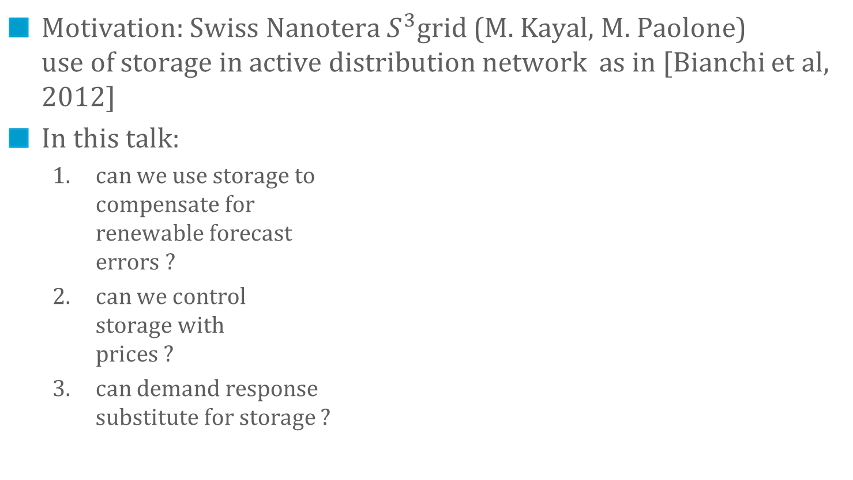
Storage and Demand Response can be used to mitigate volatility of renewables
Motivation: Swiss Nanotera $S^{3}$grid (M. Kayal, M. Paolone) use of storage in active distribution network as in [Bianchi et al, 2012]
In this talk:
can we use storage to compensate for renewable forecast errors ?
can we control storage with prices ?
can demand response substitute for storage ?

Slide 4
USING STORAGE TO CopE with RENEWABLE Volatility
1.
[Bejan et al 2012] Bejan, Gibbens, Kelly, “Statistical aspects of storage systems modelling in energy networks,” 46th Annual Conference on Information Sciences and Systems 2012
[Gast et al 2012] Gast, Tomozei, Le Boudec. “Optimal Storage Policies with Wind Forecast Uncertainties”, GreenMetrics 2012
[Gast et al 2013] Gast, Tomozei, Le Boudec. “Optimal Energy Storage Policies with Renewable Forecast Uncertainties ”, submitted, 2013

Slide 5
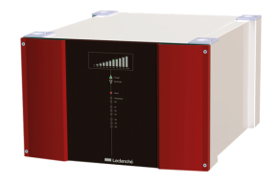
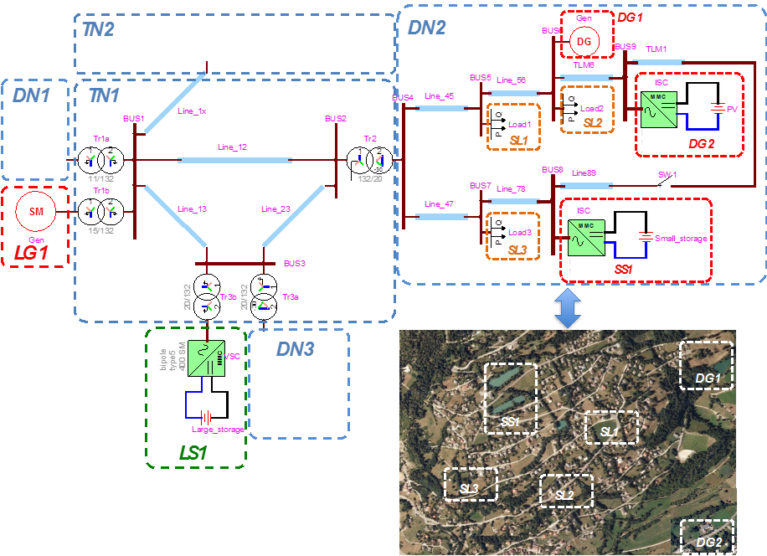
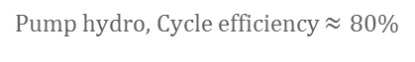
Production scheduling w. forecasts errors
Base load production scheduling
Deviations from forecast
Use storage to compensate
Social planner point of view
Quantify the benefit of storage
Obtain performance baseline
what could be achieved
no market aspects
Compare two approaches
Deterministic approach
try to maintain storage level at e.g. ½ of its capacity using updated forecasts
Stochastic approach
Use statistics of past errors.
load
renewables
renewables + storage
Pump hydro, Cycle efficiency $≈80\%$

Slide 6
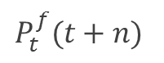
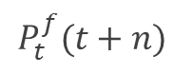
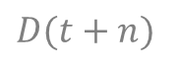
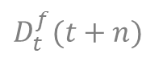
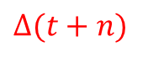
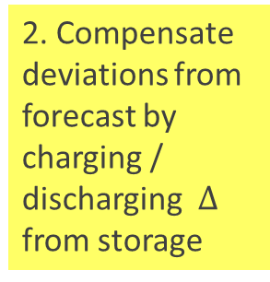
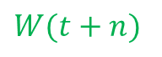
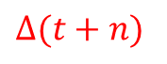
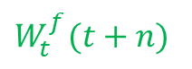
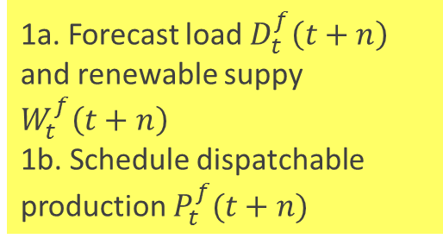
Production scheduling with delays
1a. Forecast load $D_{t}^{f}\left(t+n\right)$ and renewable suppy $W_{t}^{f}\left(t+n\right)$ 1b. Schedule dispatchable production $P_{t}^{f}(t+n)$
2. Compensate deviations from forecast by charging / discharging $Δ$ from storage
load
$$D_{t}^{f}(t+n)$$
load
$$D(t+n)$$
renewables
$$Δ(t+n)$$
renewables
$$P_{t}^{f}(t+n)$$
$$P_{t}^{f}(t+n)$$
$$W_{t}^{f}(t+n)$$
$$W(t+n)$$
stored energy
stored energy
$$Δ(t+n)$$

Slide 7
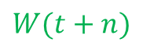
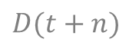
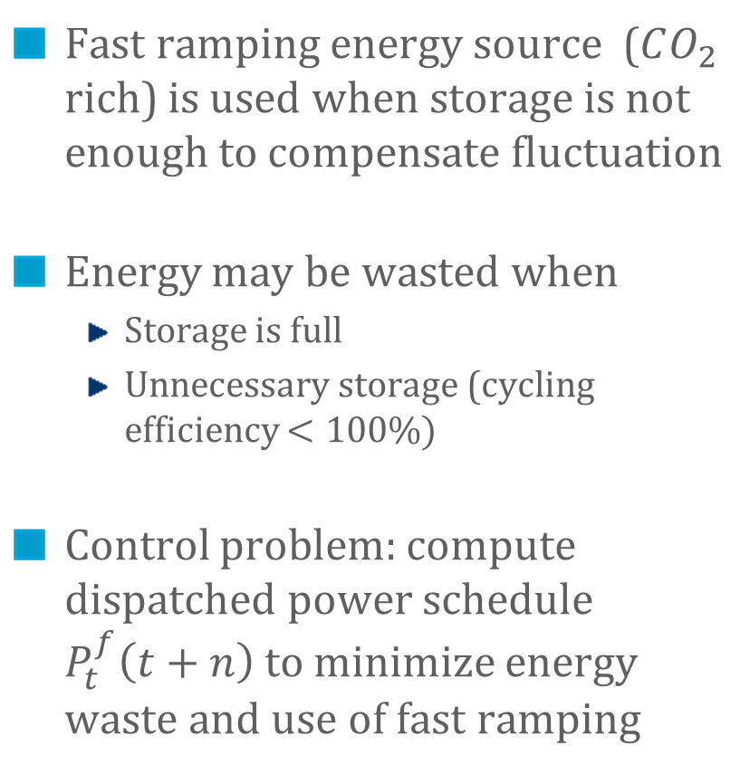
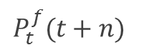
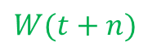
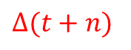
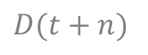
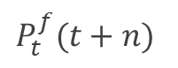
Full compensation of fluctuations by storage may not be possible due to power / energy capacity constraints
$$D(t+n)$$
load
fast ramping
Fast ramping energy source ($CO_{2}$ rich) is used when storage is not enough to compensate fluctuation
Energy may be wasted when
Storage is full
Unnecessary storage (cycling efficiency $<100\%)$
Control problem: compute dispatched power schedule $P_{t}^{f}\left(t+n\right)$ to minimize energy waste and use of fast ramping
$$Δ(t+n)$$
renewables
$$P_{t}^{f}(t+n)$$
$$W(t+n)$$
$$D(t+n)$$
load
renewables
$$P_{t}^{f}(t+n)$$
spilled energy
$$W(t+n)$$

Slide 8
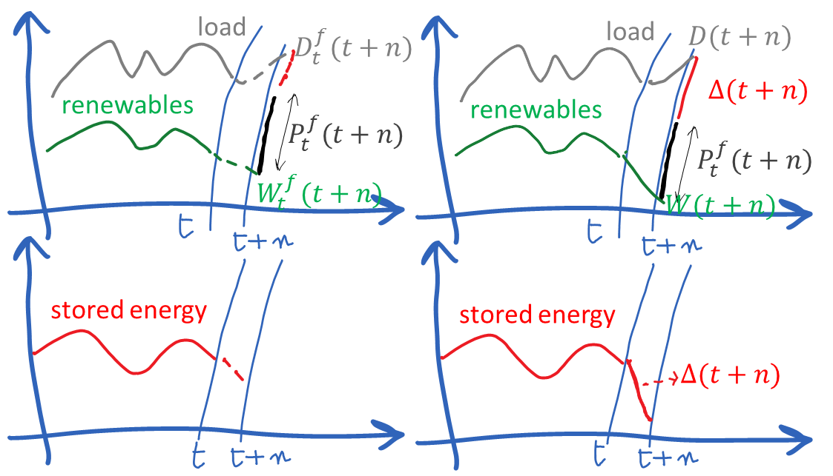
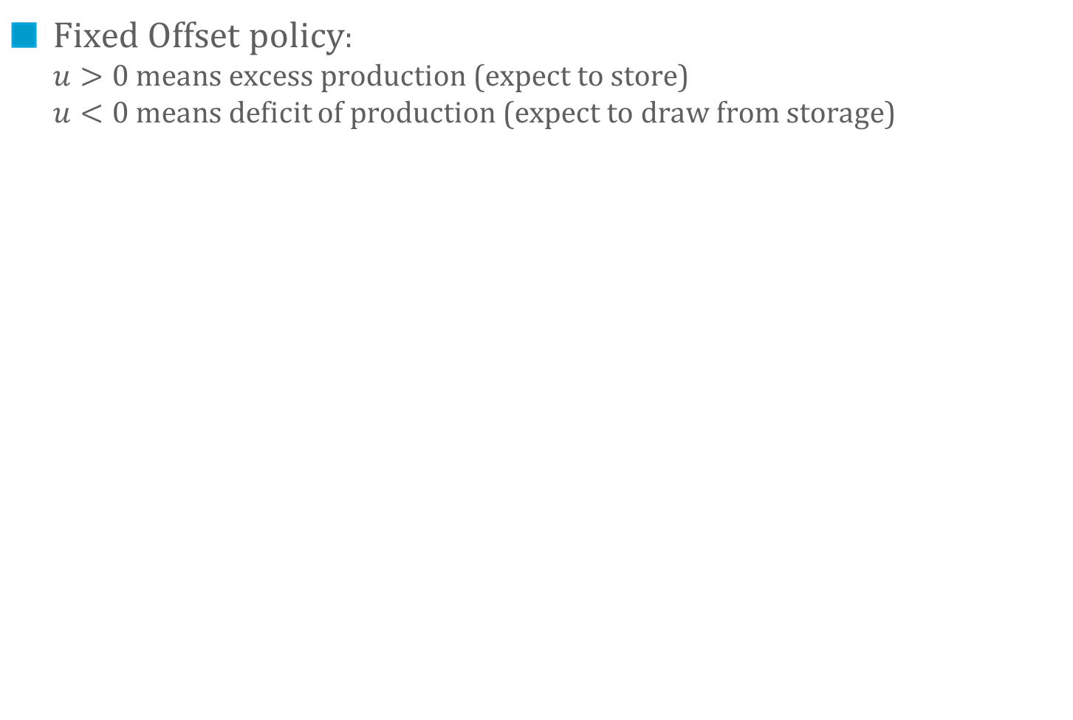
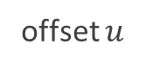
Example of scheduling policy: Fixed Offset
Fixed Offset policy: $u>0$means excess production (expect to store) $u<0$means deficit of production (expect to draw from storage)
offset $u$
Planned
Actual

Slide 9

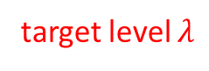
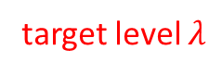
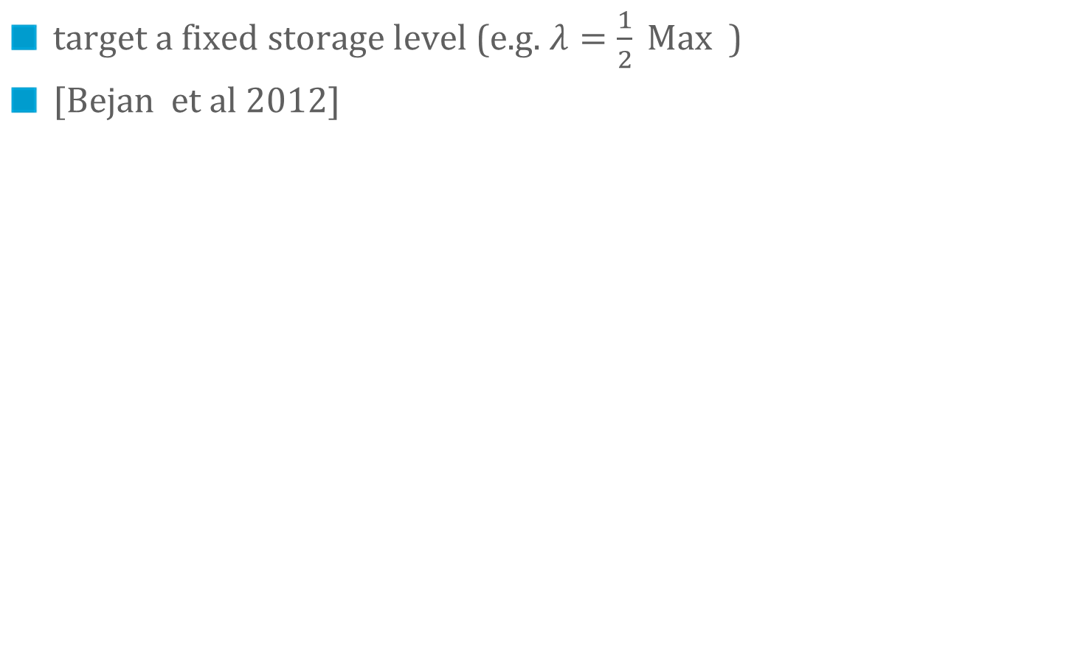
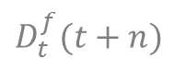
Example of scheduling policy: Fixed Level
target a fixed storage level (e.g. $λ=\frac{1}{2} Max$)
[Bejan et al 2012]
Planned
Actual
load
$$D_{t}^{f}(t+n)$$
load
$$D(t+n)$$
renewables
$$Δ(t+n)$$
$$P_{t}^{f}(t+n)$$
renewables
$$P_{t}^{f}(t+n)$$
$$W_{t}^{f}(t+n)$$
$$W(t+n)$$
stored energy
stored energy
target level $λ$
target level $λ$

Slide 10
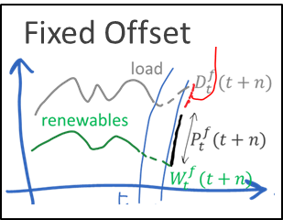
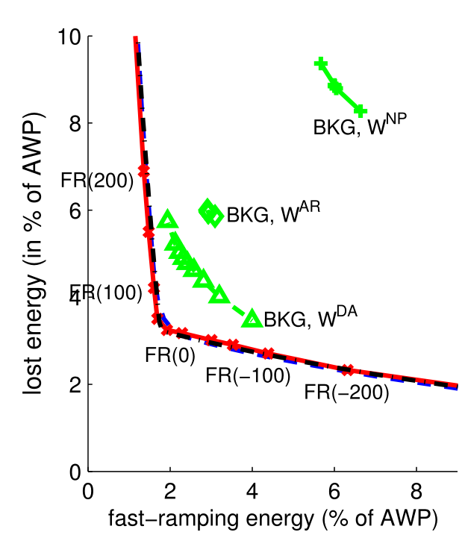
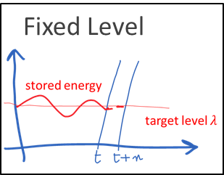
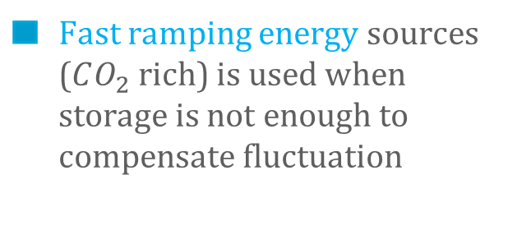
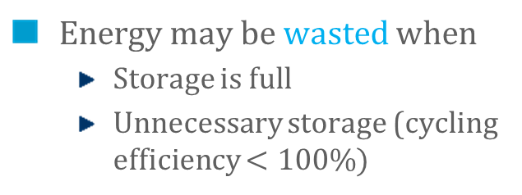
Metric and performance (large storage)
Energy may be wasted when
Storage is full
Unnecessary storage (cycling efficiency $<100\%)$
FO +200
Target=80%
Target=50%
FO +0
FO -200
Fast ramping energy sources ($CO_{2}$ rich) is used when storage is not enough to compensate fluctuation
AWP = average wind power
Numerical evaluation: data from the UK
(BMRA data archive https://www.elexonportal.co.uk/)
National data (wind prod & demand)
3 years
Corrected day ahead forecast: MAE = 19%
Questions:
Can we do better?
How to compute optimal offset?

Slide 11
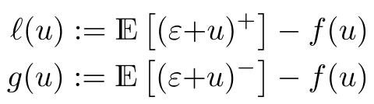
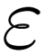
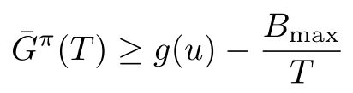
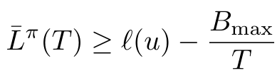
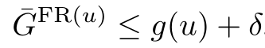
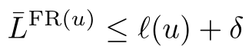
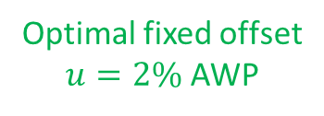
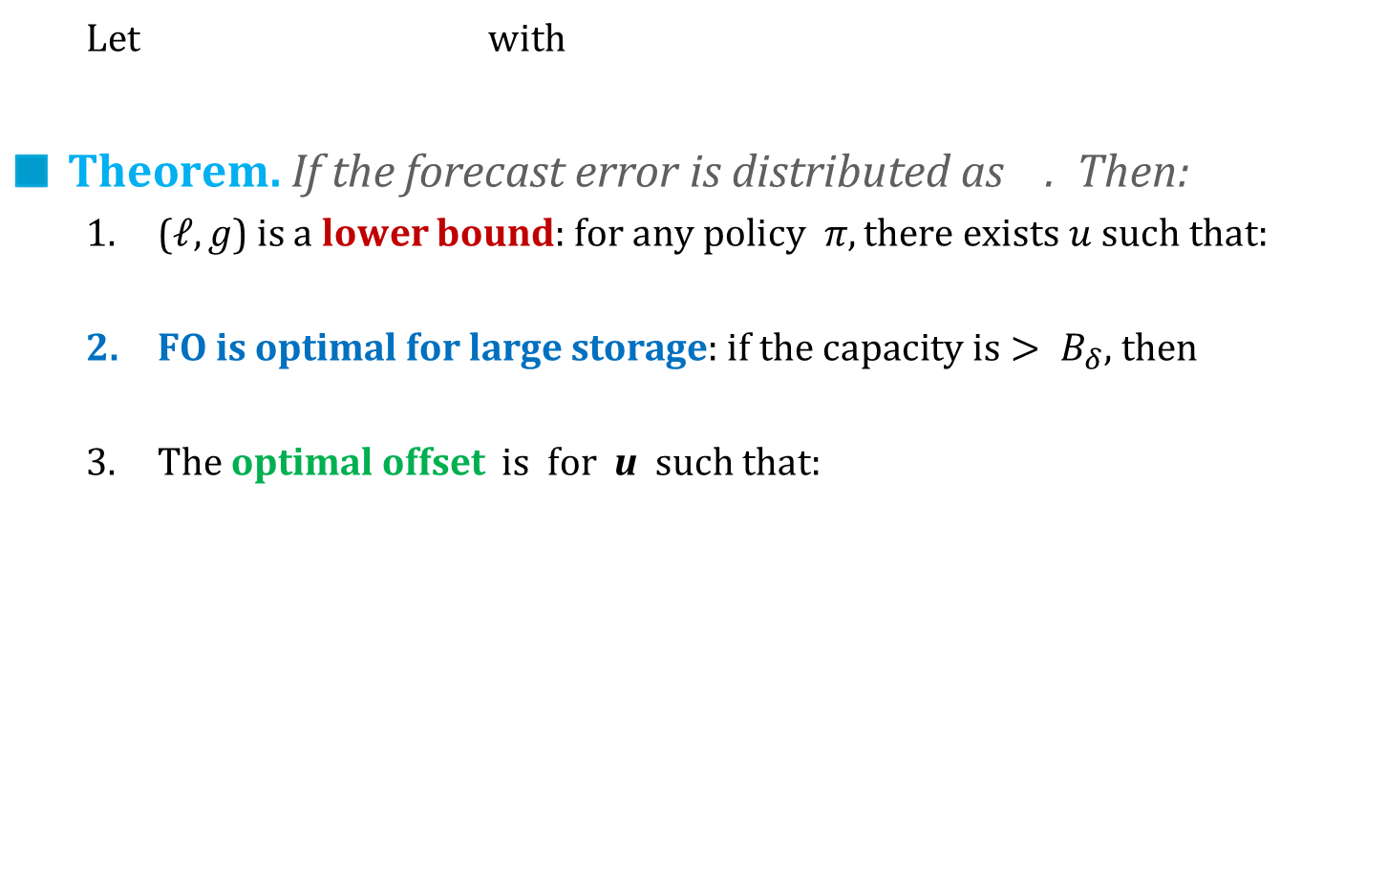
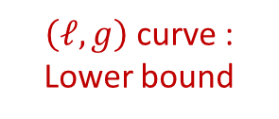
Fixed offset is optimal for large storage
Let with
Theorem. If the forecast error is distributed as . Then:
($ℓ,g$) is a lower bound: for any policy$π, there exists u such that:$
FO is optimal for large storage: $if the capacity is> B_{δ}\text{, }\text{then}$
The optimal offset is for u such that:
Problem solved for large capacity
What about small / medium capacity?
=
Target=80%
$\left(ℓ, g\right)$ curve : Lower bound
Target=50%
Uses distribution of error
Fixed reserve is Pareto-optimal
Optimal fixed offset $u=2\%$ AWP
FO
11

Slide 12
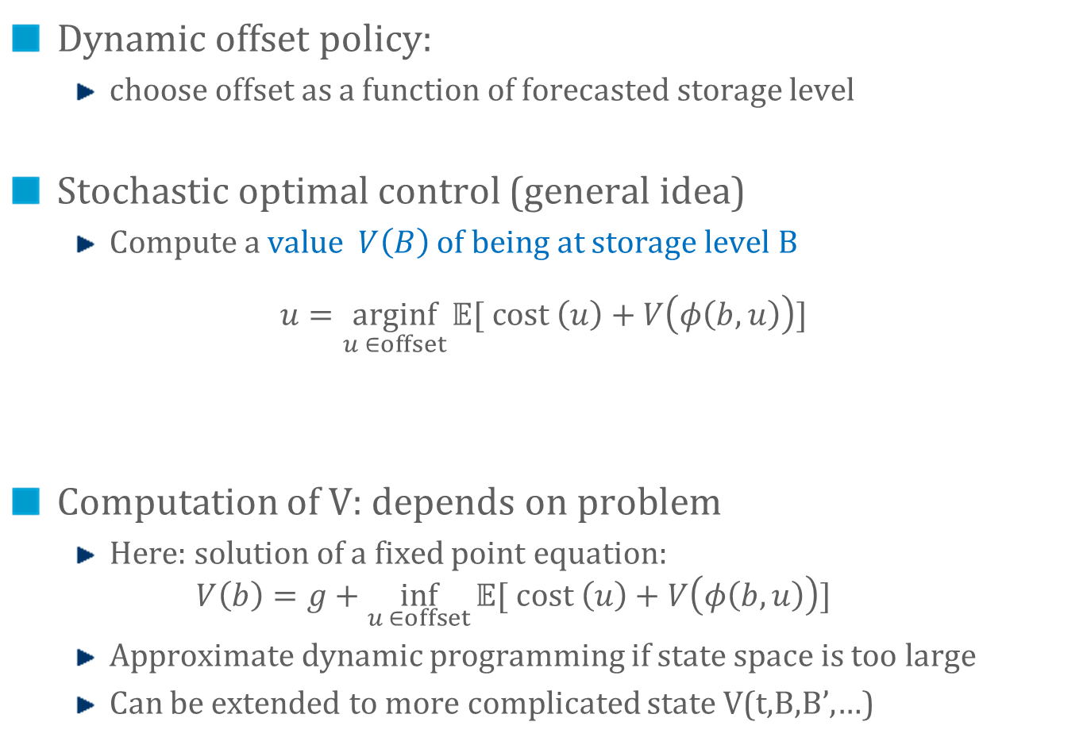
Scheduling Policies for Small Storage
Dynamic offset policy:
choose offset as a function of forecasted storage level
Stochastic optimal control (general idea)
Compute a value $V\left(B\right)$ of being at storage level B
$$u=\underset{u ∈offset}{arginf}{𝔼[ cost \left(u\right)+V\left(φ\left(b,u\right)\right)]}$$
Computation of V: depends on problem
Here: solution of a fixed point equation:
$$V\left(b\right)=g+\inf_{u ∈offset}{𝔼[ cost \left(u\right)+V\left(φ\left(b,u\right)\right)]}$$
Approximate dynamic programming if state space is too large
Can be extended to more complicated state V(t,B,B’,…)
Expectation on possible errors
Instant cost (losses or fast-ramping energy)
Storage level at next time-slot

Slide 13
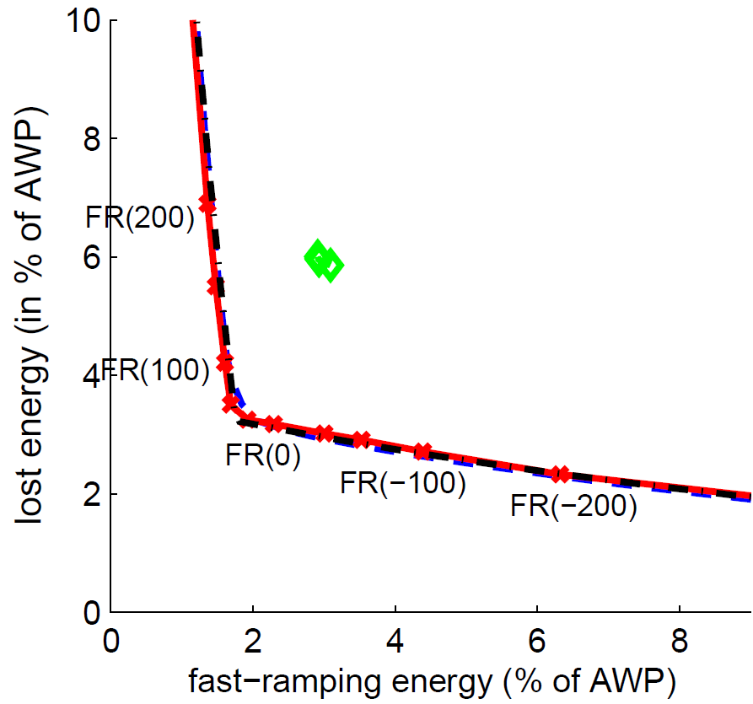
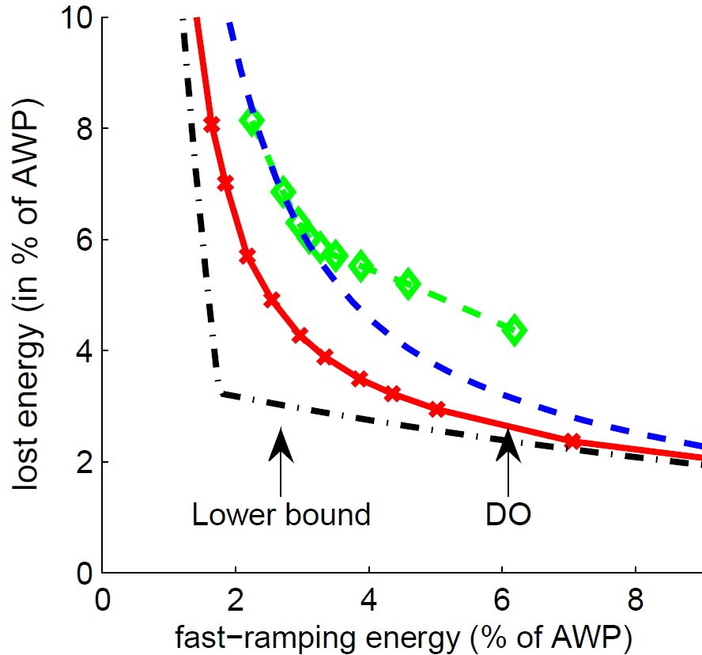
Dynamic Offset outperforms other heuristics
Large storage capacity (=20h of average production of wind energy)
Power = 30% of average wind power
Fixed Offset & Dynamic offset are optimal
Small storage capacity (=3h of average production of wind energy)
Power = 30% of average wind power
DO is the best heuristic
Fixed storage level
Fixed storage level
Fixed offset
Fixed Offset
Dynamic offset
Dynamic offset
Lower bound
Maintaining storage at fixed level: not optimal
There exist better heuristics

Slide 14
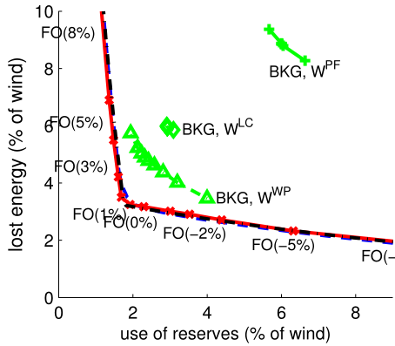
Take Home Message
For “large” (i.e. one day) storage, there is an optimal value of fixed offset reserve, which can be computed from forecast error statistics
Can be used to dimension secondary reserve
FO = 2% AWP

Slide 15
Prices AND STORAGE in Real-Time Electricity Markets
2.
[Gast et al 2013] Gast, Le Boudec, Proutière, Tomozei, “Impact of Storage on the Efficiency and Prices in Real-Time Electricity Markets”, ACM e-Energy 2013, Berkeley, May 2013

Slide 16
Storage and Real Time Prices
Impact of volatility on prices in real time market is studied by Meyn and co-authors, e.g. [Cho and Meyn, 2010] I. Cho and S. Meyn Efficiency and marginal cost pricing in dynamic competitive markets with friction, Theoretical Economics, 2010
We add storage to the model
Q1: how does storage impact volatility ? what is the required storage capacity ?
Q2: does the market provide optimal control ?

Slide 17
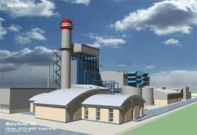
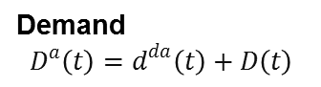
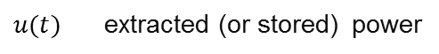





A Macroscopic Model of Real Time Market with Storage Extension of [Cho and Meyn 2010]
Control
Ramping Constraint
Randomness
Supply $$G^{a}\left(t\right)=g^{da}\left(t\right)+G\left(t\right)+Γ(t)$$
Day ahead
Demand
$$D^{a}\left(t\right)=d^{da}\left(t\right)+D\left(t\right)$$
Storage $$\frac{∂B}{∂t}=−u\left(t\right){(1}_{u\left(t\right)>0}+η1_{u\left(t\right)<0 })$$
$u(t)$ extracted (or stored) power
Storage constraints
Power Capacity $$−C_{max }≤u\left(t\right)≤D_{max }$$
Energy Capacity
$u\left(t\right)≥0$if $B\left(t\right)=B_{max}$
$u\left(t\right)≤0$if $B\left(t\right)=$0
Storage cycle efficiency (E.g. $η=0.8$ )
H: $(D−Γ)∼$ brownian motion

Slide 18




Scenario A: Storage at Supplier
Consumer
sell $E(t)$
Supplier
buy $E(t)$
Consumer’s payoff $=v\left(D^{a}\left(t\right)∧\left[E\left(t\right)+g^{da}\left(t\right)\right]\right) −c^{bo}{\left(D^{a}\left(t\right)−E\left(t\right)−g^{da}\left(t\right)\right)}^{+}−P\left(t\right)E\left(t\right)−p^{da}(t)g^{da}(t)$
Supplier’s payoff $=P\left(t\right)E\left(t\right)+p^{da}\left(t\right)g^{da}\left(t\right)−cG\left(t\right)−c^{da}g^{da}\left(t\right)$
$P\left(t\right)=$ stochastic price process on real time market
frustrated demand
satisfied demand

Slide 19


Definition of a Dynamic Competitive Equilibrium (Storage at Supplier) [Cho and Meyn 2010]
Consumer
Supplier
$$E(t)$$
$(P, E,G,u)$ such that
$E$ maximizes welfare ( = expected discounted payoff) of consumer
$E, G, u$ maximizes welfare of supplier (given friction constraints) for the same price process $P$
Without storage, there exists such an equilibrium [Cho and Meyn 2010]

Slide 20



Scenario B: Storage at Consumer
Consumer
Supplier
$$E(t)$$
Consumer’s payoff $=v\left(D^{a}\left(t\right)∧\left[E\left(t\right)+u\left(t\right)+g^{da}\left(t\right)\right]\right) −c^{bo}{\left(D^{a}\left(t\right)−E\left(t\right)−u(t)−g^{da}\left(t\right)\right)}^{+}−P\left(t\right)E\left(t\right)−p^{da}(t)g^{da}(t)$
Supplier’s payoff $=P\left(t\right)E\left(t\right)+p^{da}\left(t\right)g^{da}\left(t\right)−cG\left(t\right)−c^{da}g^{da}\left(t\right)$
Dynamic Competitive Equilibrium$: (P, E,G,u)$ such that
$E, u$ maximizes consumer’s welfare
$E, G$ maximizes supplier’s welfare for the same price process $P$

Slide 21



Scenario C: Stand-Alone Storage Operator
Consumer
Supplier
$$E_{D}(t)$$
$$E_{S}(t)$$
Consumer’s payoff $=v\left(D^{a}\left(t\right)∧\left[E_{D}\left(t\right)+g^{da}\left(t\right)\right]\right) −c^{bo}{\left(D^{a}\left(t\right)−E_{D}\left(t\right)−g^{da}\left(t\right)\right)}^{+}−P\left(t\right)E_{D}\left(t\right)−p^{da}(t)g^{da}(t)$
Supplier’s payoff $=P\left(t\right)E_{S}\left(t\right)+p^{da}\left(t\right)g^{da}\left(t\right)−cG\left(t\right)−c^{da}g^{da}\left(t\right)$
Storage Op’s payoff $=u\left(t\right)P\left(t\right)$
Dynamic Competitive Equilibrium$: (P, E_{D}, E_{S},G,u)$ such that
$E_{D}$ maximizes consumer’s welfare
$E_{S}, G$ maximizes supplier’s welfare
$u$ maximizes storage op’s welfare
$E_{D}\left(t\right)+u\left(t\right)=E_{S}(t)$ for the same price process $P$

Slide 22


Dynamic Competitive Equilibria exist and are essentially the same for the 3 Scenarios [Theorem 3, Gast et al 2013]
1 u.e. = 360 MWh 1 u.p .= 600 MW $σ^{2}$= 0.6 GW2/h
$ζ=$ 2GW/h Cmax=Dmax= 3 u.p.

Slide 23


Social Optimality
Assume a social planner wants to maximize total payoff
Total payoff is same for all 3 scenarios and is independent of price process $P(t)$
Structure of optimally social control $G,u$ Let $R\left(t\right)≔Γ\left(t\right)+G\left(t\right)−D\left(t\right)+r^{da}$ optimal control is such that if $R\left(t\right)<Φ(B(t)$) increase $G$(t) if $R\left(t\right)>Φ(B(t)$) decrease $G$(t)

Slide 24

The Social Welfare Theorem [Gast et al., 2013]
Any dynamic competitive equilibrium for any of the three scenarios maximizes social welfare

Slide 25


The Invisible Hand of the Market may not be optimal
Any dynamic competitive equilibrium for any of the three scenarios maximizes social welfare
However, this assumes a given storage capacity.
Is there an incentive to install storage ?
No, stand alone operators or consumers have no incentive to install the optimal storage
Expected social welfare
Expected welfare of stand alone operator

Slide 26



Scaling Laws
(steepness) being close to social welfare requires the optimal storage capacity
optimal storage capacity scales like $\frac{σ^{4}}{ζ^{3}}$ increase volatility and rampup capacity by $x$ = increase storage by $x$

Slide 27
What this suggests about storage :
with a free and honest market, storage can be operated by prices
however, there may not be enough incentive for storage operators to install the optimal storage size
perhaps preferential pricing should be directed towards storage as much as towards PV

Slide 28
A MODEL OF REAL TIME DEMAND RESPONSE
3.
[Le Boudec and Tomozei 2013] Le Boudec, Tomozei, “Stability of a stochastic model for demand-response”, Stochastic Systems 2013, also available at http://infoscience.epfl.ch/record/185991

Slide 29
Issue with Demand Response: Grid Changes Load
Widespread demand response may make load hard to predict
load with demand response
«natural» load
renewables

Slide 30









A Macroscopic Model of Demand Response
Macroscopic Model of [Cho and Meyn 2010]
Control
Ramping Constraint
Randomness
Supply
Natural Demand
Evaporation
Expressed
Demand
$$min⁡(E^{a}\left(t\right), G^{a}\left(t\right))$$
update term
Satisfied
Demand
Returning Demand
Frustrated
Demand
Reserve
(Excess supply)
load is delayed
Backlogged Demand
demand response

Slide 31


We obtain a 2-d Markov chain on continuous state space
Control
Ramping Constraint
Randomness
Supply
Natural Demand
Evaporation
Expressed
Demand
$$min⁡(E^{a}\left(t\right), G^{a}\left(t\right))$$
Satisfied
Demand
Returning Demand
Frustrated
Demand
Reserve
(Excess supply)
Backlogged Demand

Slide 32


The Control Problem
Control variable: $G(t−1)$ production bought one time slot ago in real time market
Controller sees only supply $Ga(t)$and expressed demand $Ea(t)$
Our Problem: keep backlog $Z(t)$ stable
Ramp-up and ramp-down constraints
$ξ ≤ G(t) ⎼ G(t−1) ≤ ζ$

Slide 33



Threshold Based Policies
Forecast supply is adjusted to forecast demand
R(t) := reserve = excess of demand over supply
Threshold policy:
if $R(t) < r∗$increase supply to come as close to $r^{∗}$as possible (considering ramp up constraint)
else decrease supply to come as close to $r^{∗}$as possible (considering ramp down constraint)

Slide 34




Simulations (evaporation $μ>0$)
Backlog $Z(t)$
Reserve $R(t)$

Slide 35

Simulations (evaporation $μ>0$)
r*
$μ>0$ means returning load is, in average, less
Large excursions into negative reserve and large backlogs are typical and occur at random times
1 time step = 10mn

Slide 36







Large backlogs may occur within a day, at any time (when evaporation $μ>0$)
t = 40 mn
t = 400 mn
t = 1280 mn
Day 1
t = 40 mn
t = 400 mn
t = 1280 mn
Day 2
Typical delay $\frac{1}{λ}=$30 mn, all simulations with same parameters as previous slide, $σ=160$

Slide 37

ODE Approximation ($μ>0$) explain large excursions into positive backlogs
r*

Slide 38


Simulations (evaporation $μ<0$)
Backlog $Z(t)$
Reserve $R(t)$

Slide 39


Simulations (evaporation $μ<0$)
$μ<0$ means returning load is, in average, more
Backlog grows more rapidly
$ξ=ζ=100, μ=−{0.15}^{,}r^{∗}=300$ 1 time step = 10mn

Slide 40

ODE Approximation ($μ<0$) shows backlog is unstable

Slide 41


Findings : Stability Results
If evaporation $μ$ is positive, system is stable (ergodic, positive recurrent Markov chain) for any threshold $r∗$
If evaporation $μ$ is negative, system unstable for any threshold $r∗$
Delay does not play a role in stability
Nor do ramp-up / ramp down constraints or size of reserve

Slide 42
What this suggests about Demand Response:
Positive evaporation is essential occurs with thermal loads, might not always occur for all load
Model suggests that large backlogs are possible and unpredictible
Backlogged load is a new threat to grid operation Need to measure and forecast backlogged load
load with demand response
«natural» load
renewables

Slide 43
Thank You !
[Cho and Meyn, 2010] I. Cho and S. Meyn Efficiency and marginal cost pricing in dynamic competitive markets with friction, Theoretical Economics, 2010
[Bejan et al 2012] Bejan, Gibbens, Kelly, “Statistical aspects of storage systems modelling in energy networks,” 46th Annual Conference on Information Sciences and Systems 2012
[Gast et al 2012] Gast, Tomozei, Le Boudec. “Optimal Storage Policies with Wind Forecast Uncertainties”, GreenMetrics 2012
[Gast et al 2013] Gast, Tomozei, Le Boudec. “Optimal Energy Storage Policies with Renewable Forecast Uncertainties ”, submitted, 2013
[Gast et al 2013] Gast, Le Boudec, Proutière, Tomozei, “Impact of Storage on the Efficiency and Prices in Real-Time Electricity Markets”, ACM e-Energy 2013, Berkeley, May 2013
[Le Boudec and Tomozei 2013] Le Boudec, Tomozei, “Stability of a stochastic model for demand-response”, Stochastic Systems 2013, also available at http://infoscience.epfl.ch/record/185991
[Bianchi et al. 2012] Bianchi, Borghetti, Nucci, Paolone and Peretto, “A Microcontroller-Based Power Management System for Standalone Microgrids With Hybrid Power Supply”, IEEE Transactions on Sustainable Energy, 2012

